Slide 1
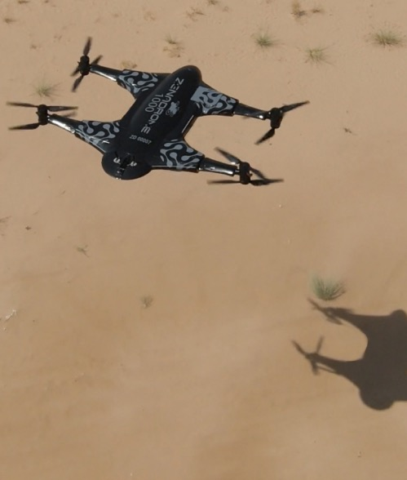

Transforming Industries
with AI Drones,
Drone as a Service
& Quantum Computing
INVESTOR PRESENTATION
JULY 2025
NASDAQ: ZENA | FSE: 49Q
www.zenatech.com

Slide 2
SAFE HARBOR STATEMENT
This presentation does not constitute an offer to sell or the solicitation of an offer to buy, nor shall there be any sale of the securities of ZenaTech, Inc. (the “Company”) in any jurisdiction in which such offer, solicitation or sale would be unlawful prior to registration or qualification under the securities laws of such jurisdiction. None of the securities of the Company have been and will not be registered under the United States Securities Act of 1933, as amended (the "US. Securities Act"), or any state securities laws and may not be offered or sold within the United States or to, or for the account or benefit of “US persons," as such term is defined in regulations under the US securities act, unless an exemption from such registration is available.
This presentation does not constitute or form part of and should not be construed as, an offer to sell or issue or the solicitation of an offer to buy or subscribe for securities of the Company in any jurisdiction or an inducement to enter into investment activity. No part of this presentation, nor the fact of its distribution, should form the basis of, or be relied on in connection with, any contract or commitment or investment decision whatsoever. No securities commission or similar authority of the United States, Canada, or any other jurisdiction has reviewed or in any way passed upon this presentation or the merits of the securities described herein, and any representation to the contrary is an offence. This presentation does not contain all of the information that would normally appear in a prospectus or registration statement under applicable Canadian or United States securities laws. Readers should not construe the contents of this presentation as investment, legal, tax, regulatory, financial or accounting advice and are urged to consult with their own advisers in relation to such matters.
This document is not, and under no circumstances is to be construed as, an advertisement or a public offering of the securities of the Company in any jurisdiction. The Company does not make any representation or warranty (express or implied) as to the accuracy or completeness of the information in this presentation. Except as may be required by applicable law, the Company expressly disclaims any obligation to update any of the information contained herein or to inform readers of any matters of which it becomes aware that may affect any matter referred to in this presentation. Certain information in this presentation is based on management estimates. Such estimates have been made in good faith and represent the current beliefs of management. Management believes that such estimates are founded on reasonable grounds. However, by their nature, estimates may not be correct or complete. Accordingly, no representation or warranty (express or implied) is given that such estimates are correct or complete. Market data and certain industry data and forecasts included in this presentation were obtained from internal company surveys, market research, publicly available information, reports of governmental agencies and industry publications and surveys.
Where this presentation quotes any information or data from any third-party source, it should not be interpreted that the Company has adopted or endorsed such information or data as being accurate. The Company has not independently verified any of such information from third-party sources or any underlying assumptions. Accordingly, the Company makes no representation or warranty (express or implied) on the fairness, accuracy, completeness or correctness of any such third-party information.
Certain statements contained in this presentation, other than statements of fact that are independently verifiable at the date hereof, may constitute “forward-looking information” within the meaning of Canadian securities legislation and “forward looking statements” within the meaning of US securities legislation “(selectively ”forward-statements”). Forward-looking statements are frequently, but not always, identified by words such as “expects,” “anticipates,” “believes,” “intends,” “estimates,” “potential,” “possible,” “projects,” “plans,” and similar expressions. Such statements, based as they are on the current expectations of management, inherently involve numerous important risks, uncertainties and assumptions, known and unknown, many of which are beyond the Company’s control. Such risks factors include but are not limited to: business risks, market risks, and risks associated with micro-cap companies. Consequently, actual future results and events may differ materially from the anticipated results and events expressed in the forward-looking statements. The Company believes that expectations represented by forward-looking statements are reasonable, yet there can be no assurance that such expectations will prove to be correct. The reader should not place undue reliance, if any, on any forward-looking statements included in this presentation. These forward-looking statements speak only as of the date made, and the Company is under no obligation and disavows any intention to update publicly or revise such statements as a result of any new information, future event, circumstances or otherwise, unless required by applicable legislation or regulation.

Slide 3
INVESTMENT HIGHLIGHTS
Enterprise SaaS Software Company that designs and manufactures AI drones
Selling to fastest growing sectors - Defense, Agriculture, and Commercial sectors
Growing a Global Drone as a Service business for convenient Uber-like drone services
Growth by Acquisition adding to tech solutions, services and customers, revenue accretive
Favorable Capital Structure - 60% Founder and management team owned & 90% of debt held by private investors

Slide 4
CAPITALIZATION
SUMMARY
Stock Symbol | NASDAQ: ZENA FSE: 49Q
Stock Price (As of 07/24/25) | $6.01
Common Shares Outstanding | 35,981,124
Market Capitalization | $145M
Warrants Outstanding | 1,995,551
At least 60% of shares owned by Founder, Insiders

Slide 5
ZENATECH - REVENUE MODELS
Enterprise SaaS Software
$2M Sales, 2024
Drone as a Service (DaaS)
Launched November 2024
Drone Solutions, at Paid Trials Stage
SaaS - Annual license
Support & Maintenance
Software Development
Training
Q1 sales $1.13M ≈ half DaaS
DaaS annual subscription membership and per fee use
Drone management fee
Hardware/software application customization
Drone hardware and accessory sales
Drone management fee
Drone software license
Drone warrantee (hardware and accessory replacement)
Hardware/software customization
Software maintenance and support
Sales Channels:
Digital Marketing, Sales &
Customer Support
Sales Channels:
Digital Marketing, Direct Sales, JV Distribution Partners and resellers
Sales Channels:
Direct Sales,
JV Distribution Partners

Slide 6
GLOBAL DRONE MARKET
GROWTH, COMMERCIAL VERTICALS
Commercial drone market growing from $8.8B in 2022, expected to reach $82.5B by 2032*
Military drones growing from $14B in 2023, expected to reach $47B in 2032*
25-30%
20-25%
Agriculture/Precision Farming
Infrastructure & Construction
15-20%
15-20%
Logistics & Delivery
Media & Entertainment
10-15%
5-10%
Security & Surveillance
Environmental Monitoring/Mgmt.
Industry Drivers
FAA/other aviation authorities- historic policy directives positively impacting US drone makers
Tech innovation- drone batteries, lighter fuselage, AI and quantum
US and other government policy shifts banning Chinese drones & components that currently dominate the industry
Geographic Breakdown
Commercial Drone Market Size (USD$)*
$82.5 Bn
$55.8 Bn
$8.8 BN
2022
2024
2026
2028
2030
2032
Source Industry Drivers/Sector size- Drone Life.com report on where the industry will grow the fastest by 2030- at 22/09/06, Military Drone market from Fortune Business Insights Research
*Sources: Skyquest and Straights Research

Slide 7


GEOGRAPHIC PRESENCE AND GROWTH
Germany
Germany
Ireland
Ireland
Vancouver
Portland
Oregon
Phoenix, AZ
Phoenix
Toronto
Phoenix, AZ
Toronto
Chicago, IL
UAE
Chicago, IL
Florida,
5 Offices
Taiwan
Florida,
5 Offices
DUBAI
Manufacturing Sites
Manufacturing Sites
Global Offices
Global Offices
Existing Markets Served*
Existing Markets Served*
Future Markets for JV drone solution partners in upcoming months
*Enterprise Software Customers are in US, Canada and Germany

Slide 8
COMPANY MILESTONES
Secured US defense pilot/testing drone contracts (Air Force & Navy)
Moved drone manufacturing to new 10,000 sq ft. facility in Sharjah, UAE
Acquired 6 Land Survey Companies
Acquired Othership
Launched IQ Square Launch
Expanded Arizona Manufacturing Facility
ZenaTech established, (ZenaPay) software development for agriculture industry
Beta tested the ZenaDrone 1000 in farmlands in Ireland
Acquired PsPortals
Acquired SystemView and PacePlus
2018
2020
2022
2024
2017
2019
2021
2023
2025
Listing on Nasdaq Capital Markets
Acquired Four Additional Software Companies
Launched DaaS business model & Quantum Project
Frankfurt listing
Launched IQ Nano
Established Spider Vision Sensors - Taiwan
Developed agricultural plant tracking technology
ZenaTech spun off from parent
Acquired WorkAware and TillerStack
Opened first drone production facility, Dubai, UAE, 3,000 sq. ft.
Launched of the ZenaDrone 1000
ZenaDrone established

Slide 9

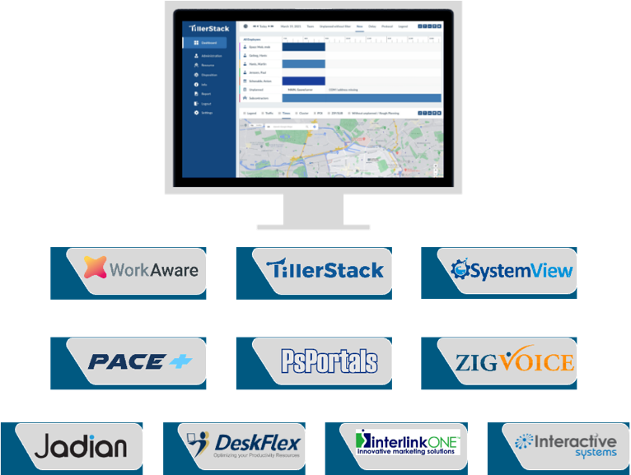
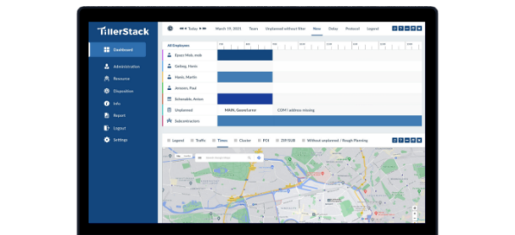
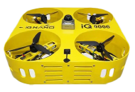
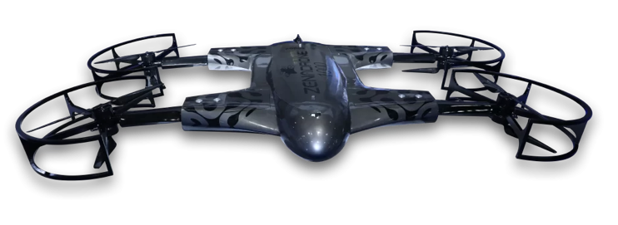














OUR OFFERINGS
Drone Technology Solutions
Enterprise Software Solutions
1000
IQ
DRONE as a SERVICE MODEL (DaaS)

Slide 10
ZENADRONE PRODUCTS - ZENADRONE 1000
Defense Applications - inspection, surveillance, reconnaissance, cargo and border patrol
Precision Agriculture - sprayer attachment and scanners
Gas Version in Development - flies for several hours
Proprietary Dronenet Communications System
Completed Paid Trials with Air Force and Navy
7 X 12 feet
ZenaDrone 1000
Stable Flight, Exceptional Maneuverability, Advanced Scanning, Multiple Attachments, and Heavy-lift Capabilities
Sells for: $100-250K plus software

Slide 11
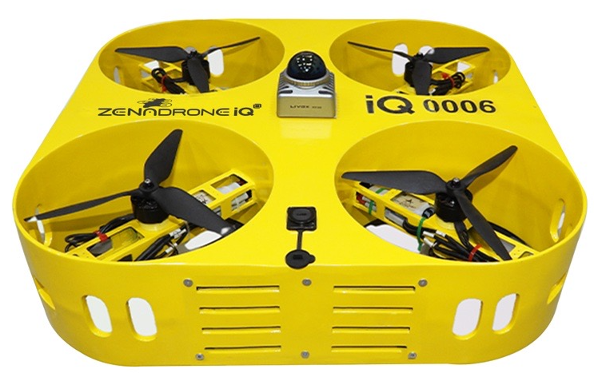
ZENADRONE PRODUCTS - IQ SERIES
20″ × 20″ and 30” x 30”
40” x 40” and 50” x 50”
ZenaDrone IQ NANO
A compact indoor inventory drone, operates in GPS-denied environments like warehouses or military armories, obstacle avoidance technology
ZenaDrone IQ Square
A VTOL outdoor engineered for line-of-sight land surveys, infrastructure and other outdoor inspections, as well as inspections and reconnaissance tasks for defense

Slide 12



CURRENT CUSTOMER DRONE APPLICATIONS
Agriculture
Help farmers cultivate higher yields, reduce labour and expenses utilizing plant tracking and Smart Farming solutions.
Benchmark growth, scouting disease
Fertilizer and Pesticide Spraying
Crop and Fruit Farm Imaging
Irrigation and Soil Management
Defense And Government
Search and rescue, disaster response and
humanitarian aid
Crowd monitoring and border patrol
Operations inspection, intelligence gathering and security
Firefighting and water spraying
Paid pilots by US Air Force and Navy for critical medical supply delivery in field operations, and for sub-zero climate deliveries.
Warehouse and Logistics
Paid pilot in progress with multinational auto parts manufacturer automating inventory management via bar code scanning.
Warehouse security and surveillance
Aisle and safety inspections
Picking, packing and parcel sorting
Warehouse mapping

Slide 13




FUTURE CUSTOMER DRONE APPLICATIONS
Oil and Gas
Pipe, flare stack and chimney inspection
Offshore platform monitoring
Site surveying and mapping
Safety, compliance and environmental monitoring
Security of sites and asset management
Mining and Construction
Monitoring and security of indoor and outdoor assets
Safety and compliance inspections
Terrain mapping and site survey applications
Automation of processes, paperwork data collection and analysis/AI
Forestry and Environmental
Land surveys, animal tracking/migration
Forest management, seed planting for reforestation
Environmental planning and compliance
Forest fire and emergency management
Renewable Energy
Pipe, flare stack and chimney inspection
Offshore platform monitoring
Site surveying and mapping
Safety, compliance and environmental monitoring
Security of sites and asset management

Slide 14

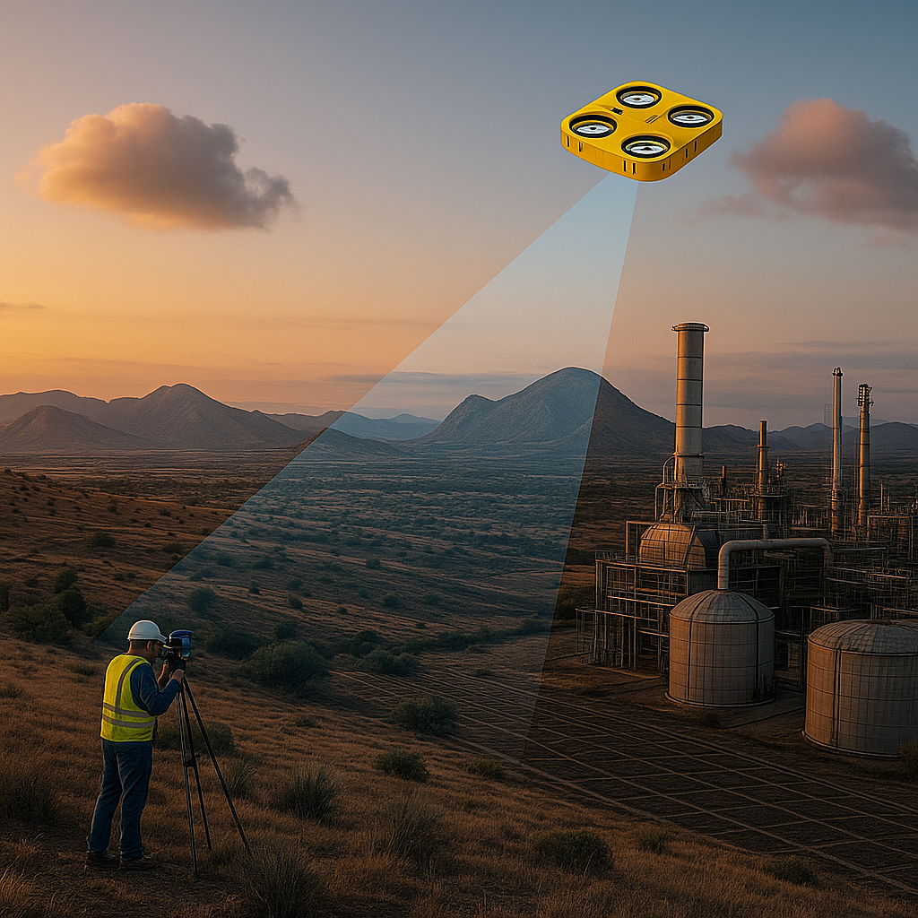
DRONE AS A SERVICE (DaaS)
Phase 1 Implementation Now- Land Survey Engineering Company Acquisitions
Phase 2- DaaS Branded Business- Multiple Services
Convenient Subscription-based Drone Services for Business and Government
No Hardware/Software Purchase, No Drone Pilots Required, No Maintenance or Regulatory Certification Concerns

Slide 15
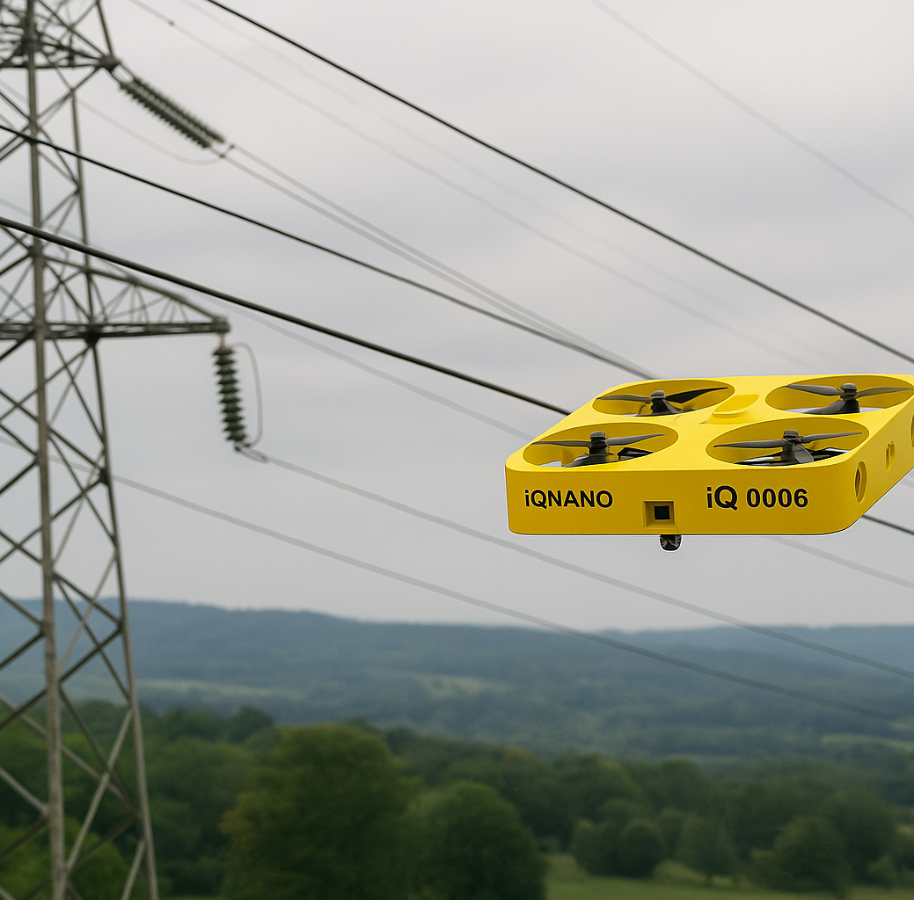

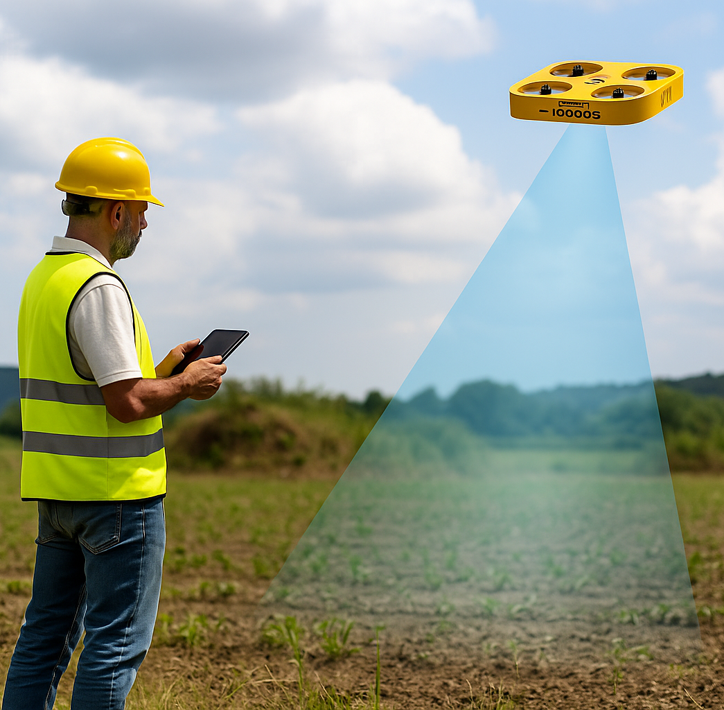

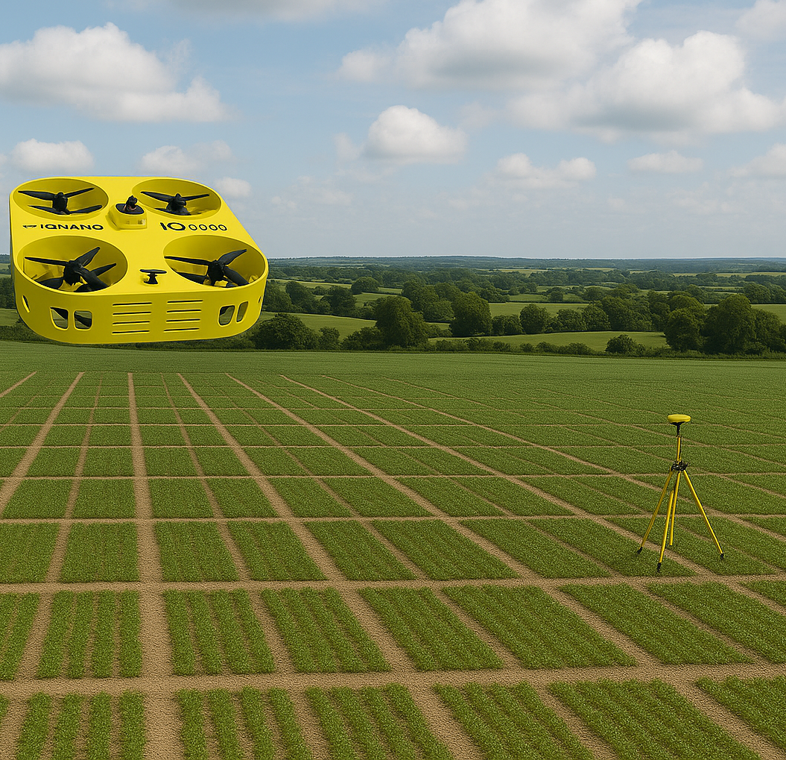
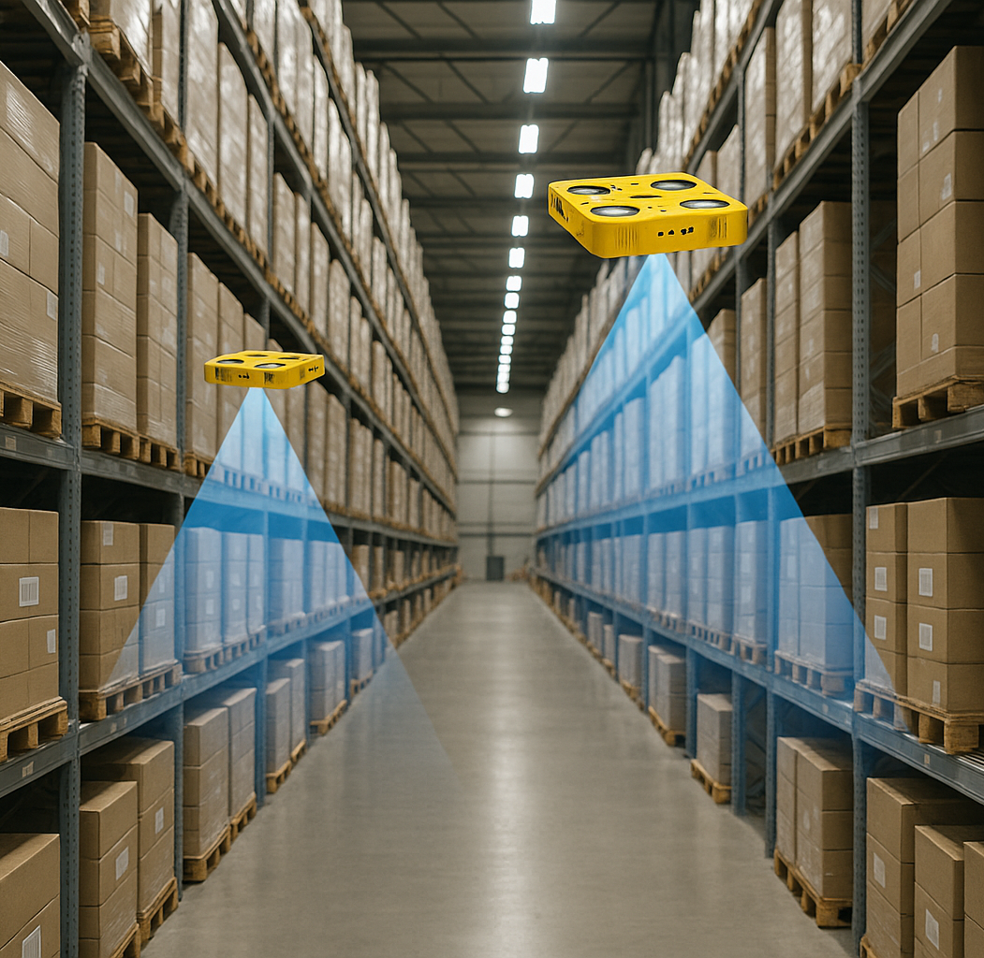
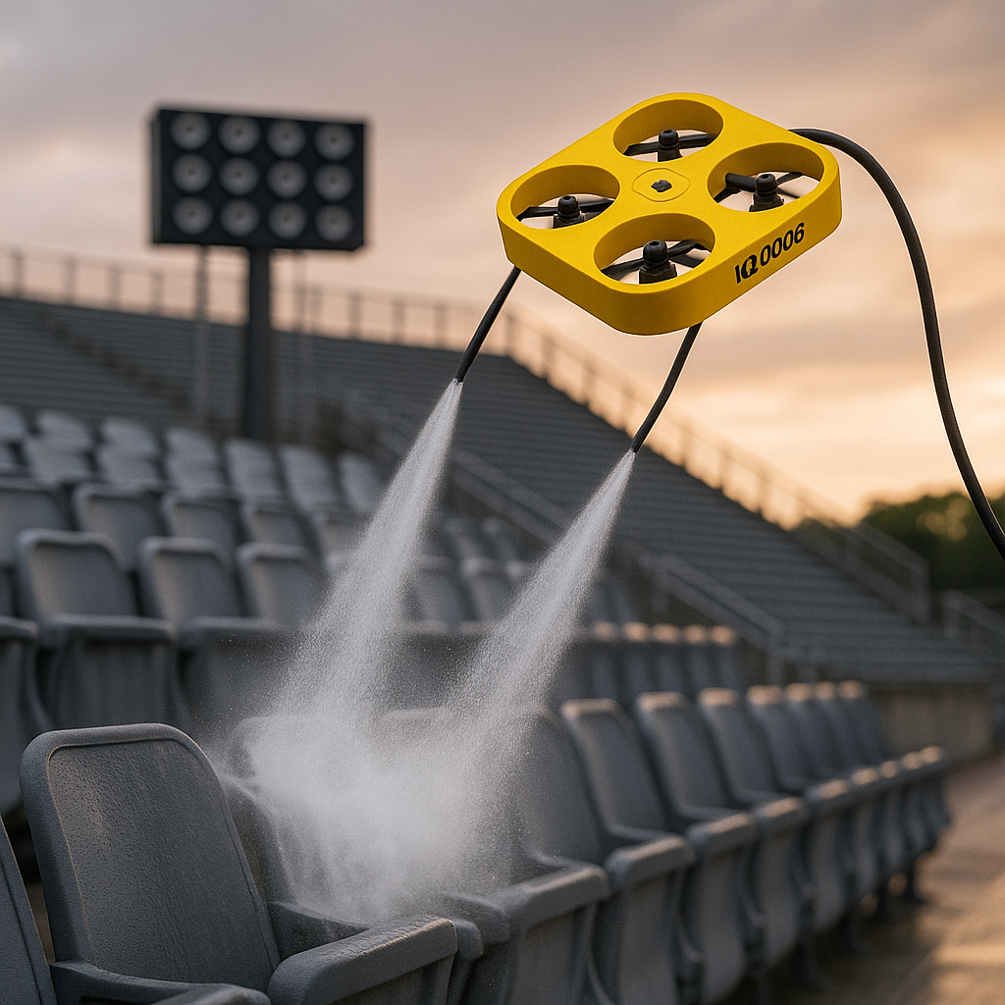
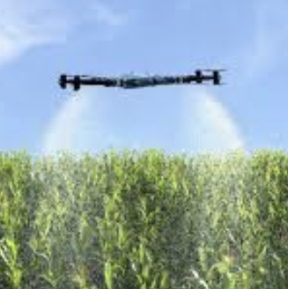
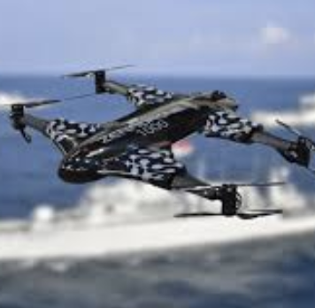
Powerline Inspection
Maintenance Inspection
Line-of-Site Land Surveys
Inventory Management
Power Washing
Precision Agriculture
BVLOS Inspections

Slide 16



DaaS NATIONAL ROLLOUT-ACQUISITIONS
Portland, OR
REGIONS:
North West
South West
Northern
North East
South East
Southern
Central West
Maimi area
Palm Beach, FL
Pensacola, FL

Slide 17






















HIGHLIGHTED SOFTWARE CUSTOMERS

Slide 18
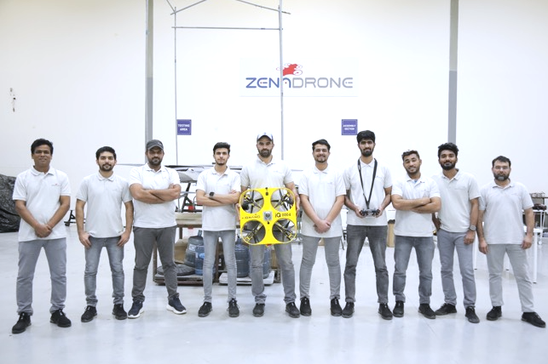
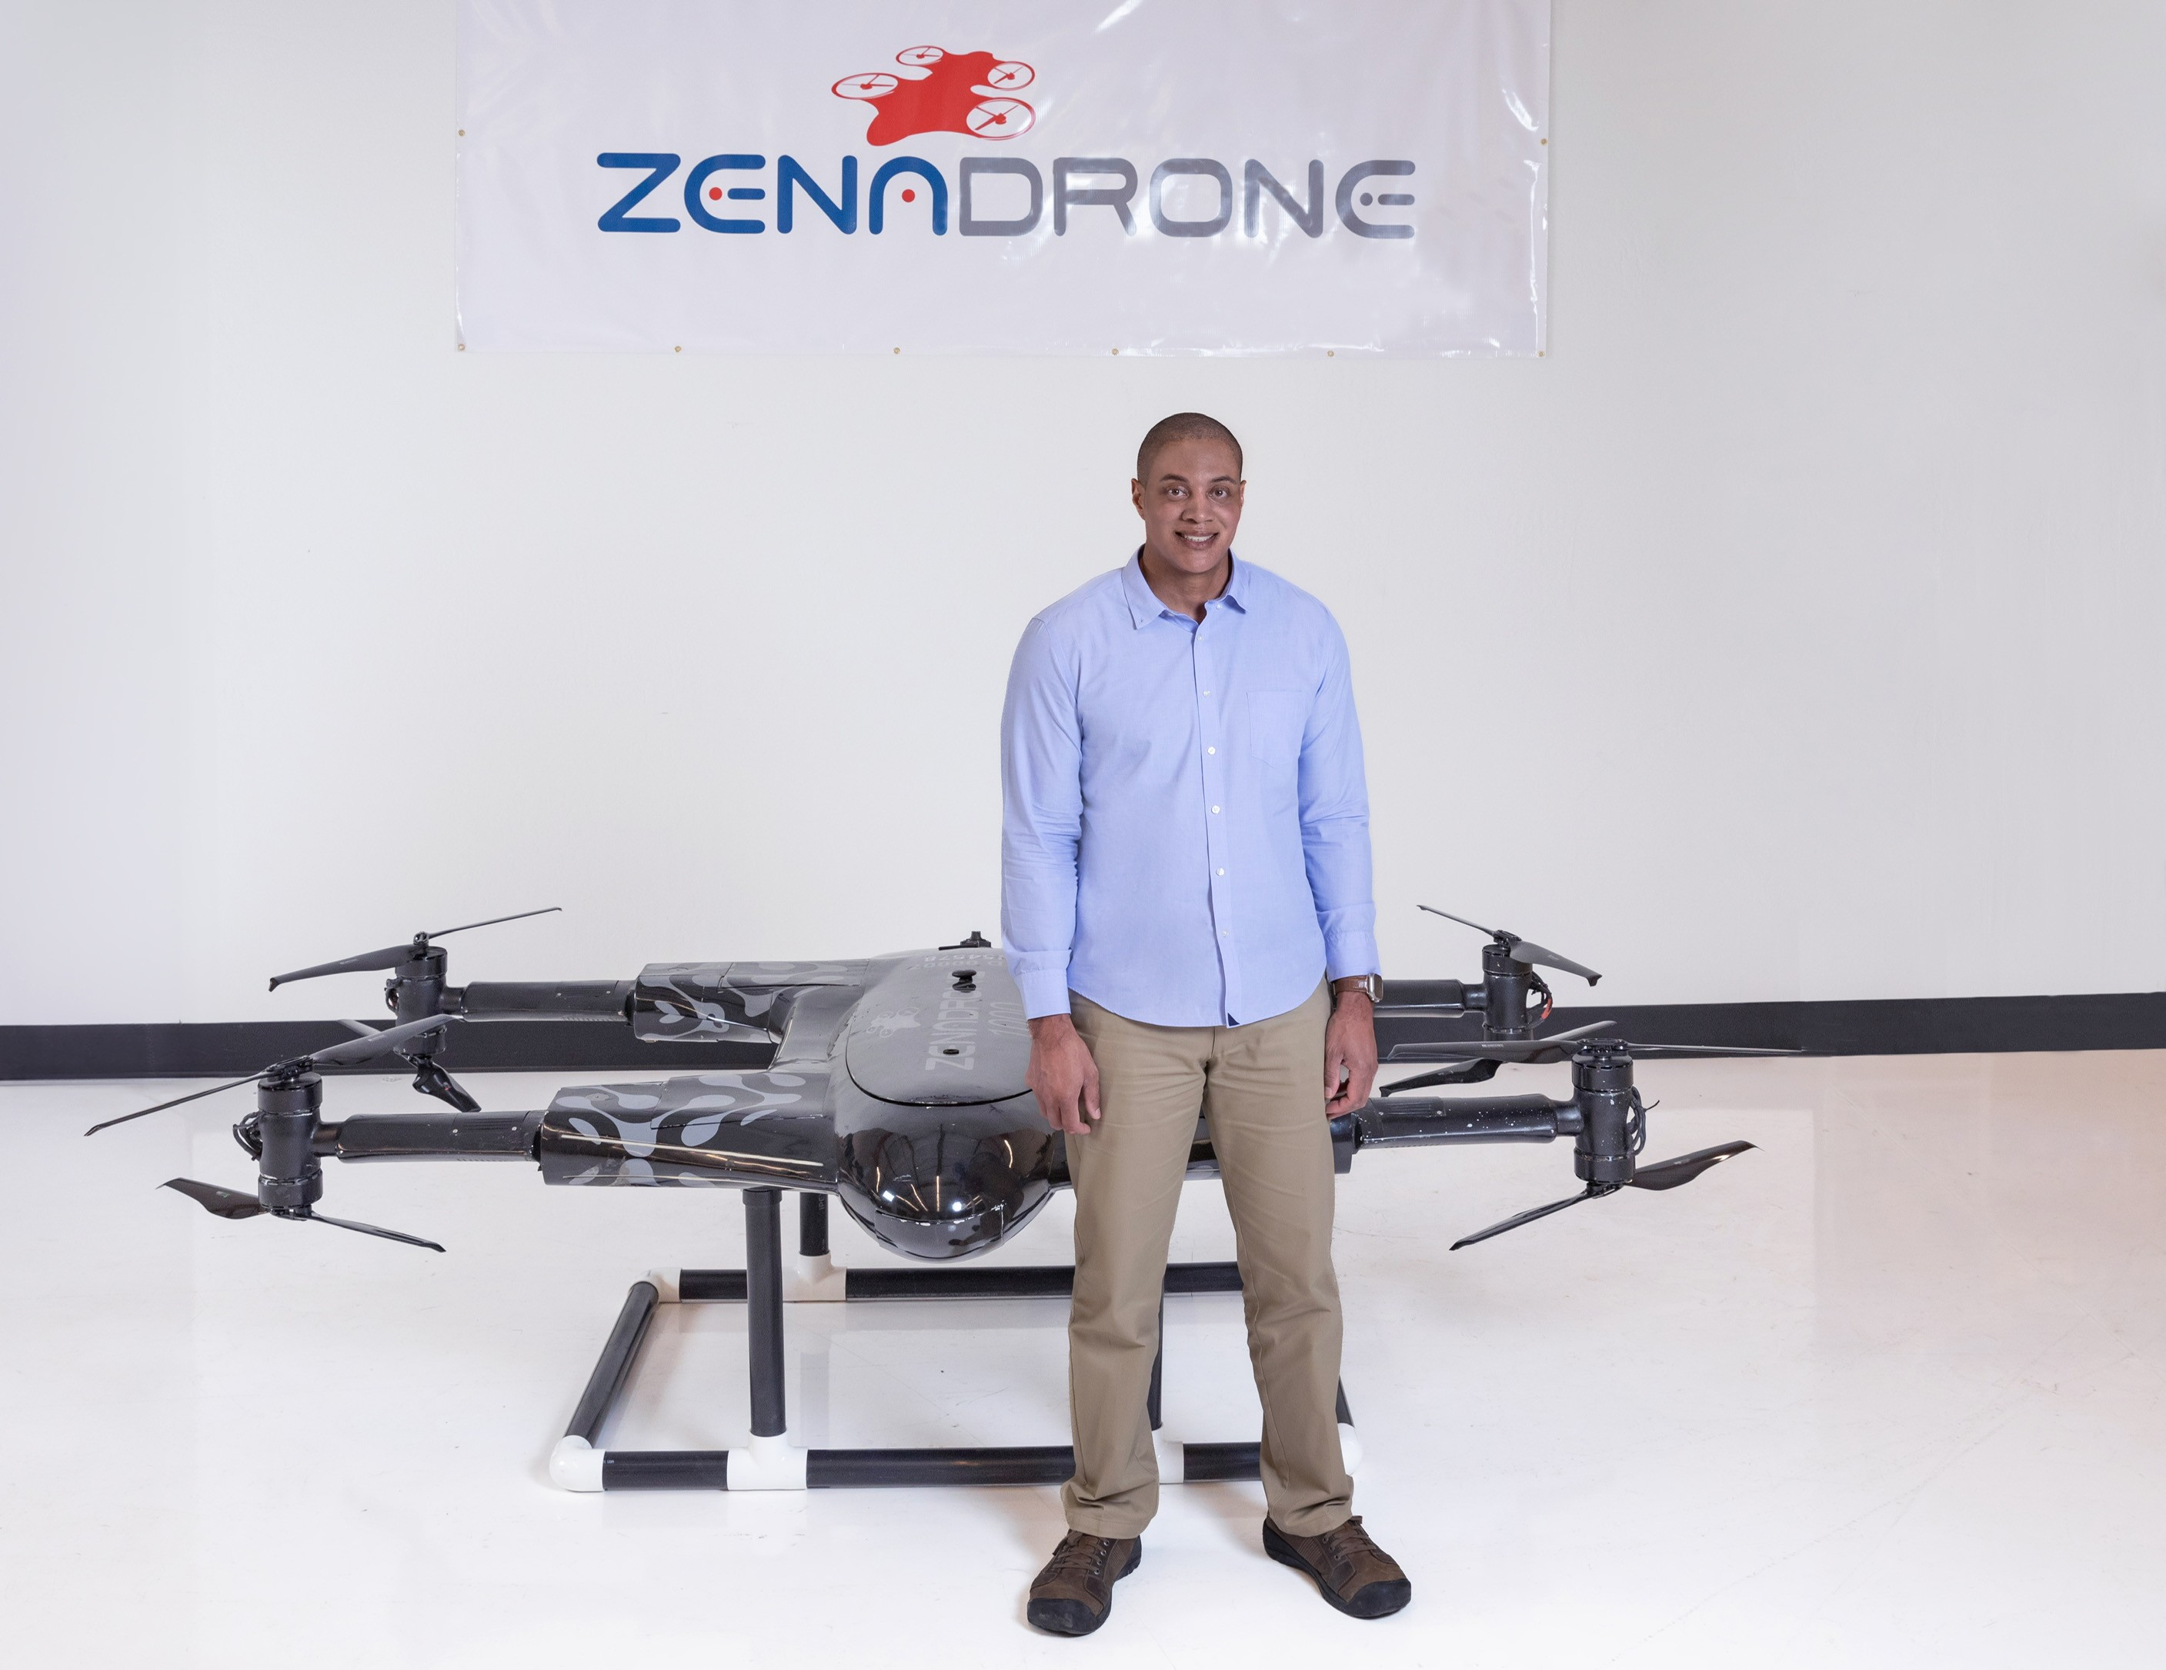
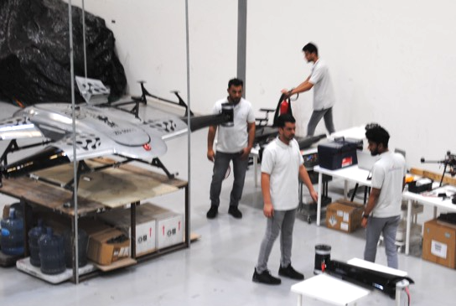
DRONE MANUFACTURING
UAE production facility established 2022, expanded to 10,000 sq feet in 2023
Produced and tested 14 successive prototypes of ZenaDrone 1000, #15 is Production model
Production capability of 10-15 ZenaDrone 1000 models per month
Production capability of 25+ IQ Nano/IQ series drones per month
Arizona production facility- R&D, sales, aerial testing, setting up manufacturing site for US Military drones
Spider Vision Sensors in Taiwan established Nov. 2024, US military-compliant cameras in Q1, plus other components/supply chain for our drones

Slide 19

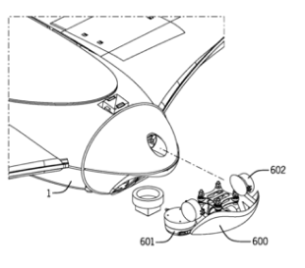
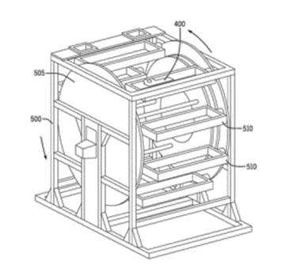
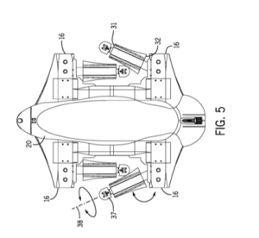
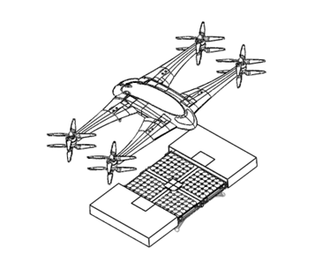
IP PORTFOLIO OVERVIEW
2 Patents for Drone Design
ZenaDrone 1000
2 Patents for Drone Attachments including:
Drone with extendable and rotatable wings and multiple accessories securing panel
Charging/Re-Charging Drone Assembly Systems and Apparatus Pad

Slide 20
EXECUTIVE LEADERSHIP TEAM
SHAUN PASSLEY, PHD | CHAIRMAN & CHIEF EXECUTIVE OFFICER
Over 25 years of expertise in the software industry, more than 10 years leading public companies
Serves as CEO and Chairman of the Board of ZenaTech
Holds a PhD in Business Management and a master’s in business administration from Benedictine University. Also has four master’s degrees; a Master of Law from Northwestern University, a Master of Science in Information Technology from DePaul University, and a Master of Science in Product Design from Northwestern University
A distinguished figure in the tech and business world
JAMES SHERMAN, CPA | CHIEF FINANCIAL OFFICER
Has worked for 30 years as a Certified Public Accountant (CPA). Graduated with Honors from Northern Illinois University
Started career at a Fortune 500 telecommunications firm, rising through the ranks of finance roles
Served as Treasurer for a $3.5 billion division of Sprint Corporation, led a $50 million cost-saving initiative
CFO of a $90 million national transportation and distribution company, led a turnaround from potential bankruptcy to ready for sale
Served as CFO for Carry Corporation, a $250 million division of Mitsubishi Corporation
SAJJAD ASIF | CHIEF TECHNOLOGY OFFICER
18 years of professional experience and expertise in software and drone technologies
Holds Master of Science in Software Engineering degree from Blekinge Tekniska Högskola (BTH) in Sweden, an MBA from AIOU in Pakistan, and a BS - Computer Science from PUCIT in Pakistan
Held leadership positions with the ZenaTech group of companies, now focused on ZenaDrone solutions and integration
Held CTO and other leadership and technical roles for multiple European technology firms

Slide 21



EXECUTIVE TEAM
LINDA MONTGOMERY | VP CORPORATE DEVELOPMENT
Over 20 years of global technology industry background leading investor relations, business development, and marketing
Has led investor relations for multiple companies and for six IPOs, joined the ZenaTech prior to public offering
Previously held national marketing leader roles at IBM, KPMG, Telesat Canada, and general manager for a venture builder agency
Two business degrees from the University of Winnipeg and the University of Manitoba, holds an Investor Relations Accreditation (CPIR) is from the Ivey School of Business at Western University and the Canadian Investor Relations Institute
SIMON HENRY | VP OF BUSINESS DEVELOPMENT, EMEA
Over 20 years of sales and client service management in various industries, including finance with the Bank of Ireland
3 years at ZenaTech leading ZenaDrone customer/partner growth in Ireland and pioneering relationships in EMEA regions
Previously roles leading business development, sales, and client service management for companies in global payroll outsourcing, fleet management, and business incentives achieving sales and business objectives
Degree in Business Studies from Dublin Business School (Honors) and a Masters Degree in Sales Management from UCD Michael Smurfit Graduate Business
PHILANDER FRANKLIN | VP OF BUSINESS DEVELOPMENT, NA
Over 25 years of professional experience in sales and operations leadership
Over 10 years with ZenaTech companies leading customer support, operations management, partnerships, and regulatory affairs
Previously a sales leader in the healthcare insurance industry for Blue Cross Blue Shield provider, GoHealth, achieving top awards for sales and revenue
Led the growth of a multi-store retailer in Chicago, significantly expanding stores, operations and staff in a two-year period

Slide 22


COMPETITIVE DIFFERENTIATION
Company | Application |  |  |  | Size/Range |  |  | Platform |  | Functionality
 | Military/ Defense | Commercial | Public Safety | Drone As A Service (DaaS) | Small Indoor | Small Outdoor | Medium Outdoor | Fixed Wing | Rotary | AI
 | ✓ | ✓ | ✓ | ✓ | ✓ | ✓ | ✓ | ✓ | ✓ | ✓
Red Cat | ✓ | ✓ | ✓ |  |  | ✓ | ✓ | ✓ | ✓ | ✓
Draganfly | ✓ | ✓ | ✓ |  |  | ✓ | ✓ |  | ✓ | ✓
AgEagle | ✓ | ✓ | ✓ |  |  | ✓ | ✓ | ✓ |  | ✓
Ondas Holdings | ✓ | ✓ | ✓ |  |  |  | ✓
AeroVironment | ✓ | ✓ | ✓ |  |  | ✓ | ✓ | ✓ | ✓ | ✓
Skydio | ✓ | ✓ |  |  |  | ✓ | ✓ | ✓ | ✓ | ✓

Slide 23





REGULATORY APPROVAL STATUS
Approval Granted
Federal Aviation Administration (FAA)
Dubai Civil Aviation Authority and Ministry of Defence
Country | Regulatory Body | Approval Status | Approval time
 | Canadian Transport Authority | Not Applied | 8-9 weeks
 | EASA-European Union Aviation Safety Agency | Not Applied | 8-10 weeks
 | Irish Aviation Authority | In-progress | 12-20 weeks

Slide 24
INVESTMENT SUMMARY
Green then Blue UAS Certification in Progress, Work on Winning Defense Contracts
Meet Monthly UAE Manufacturing Goals, Build Arizona Manufacturing Facility and Capacity
Close 20 More Acquisitions- Next 12 Months
Acquisitions Become Branded DaaS Multi-Service Businesses
Advance Indoor Inventory Drone and Agriculture Drones and Sales Opportunities
Work on Quantum Computing R&D Projects, AI Drone Fleets & Next Generation Solutions

Slide 25
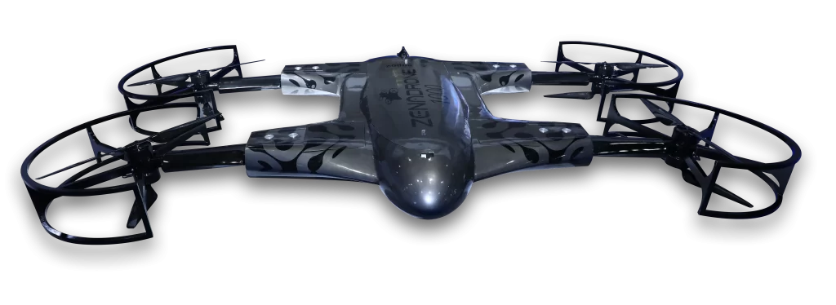
Contact Information:
Linda Montgomery
VP, Corporate Development
investors@zenatech.com
Mike Mason
CoreIR
www.zenatech.com
NASDAQ: ZENA | FSE: 49Q

